Slide 1
Methods for Artificial Intelligence
Alexander Jung, Computer Science/Aalto

Slide 2

AI TRANSFORMS OUR LiFE!
helps us to
find nearest supermarket
find partners
find new job
find that cool background song
…

Slide 3

Kill BILL
https://youtu.be/a3aFv8IQb4s?t=553

Slide 4
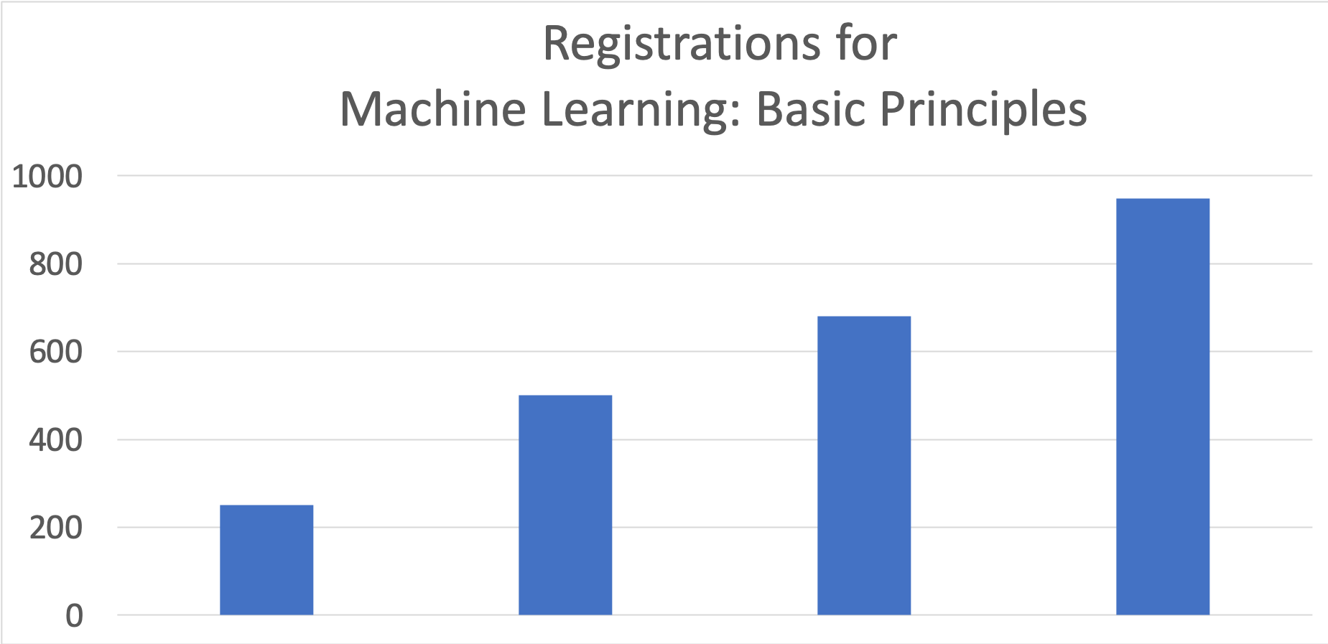
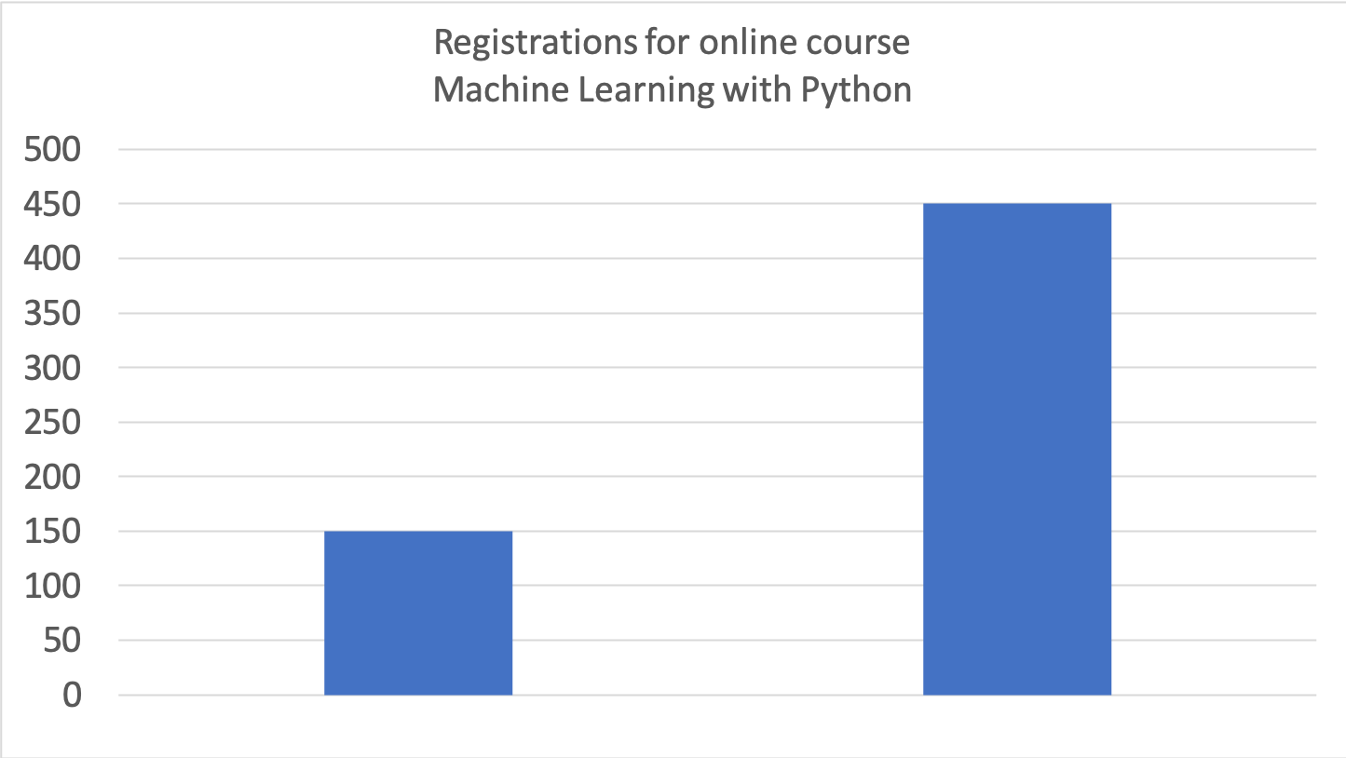
Courses on ML ROCKET !
2015
2016
2017
2018
2019 spring
2019 fall

Slide 5
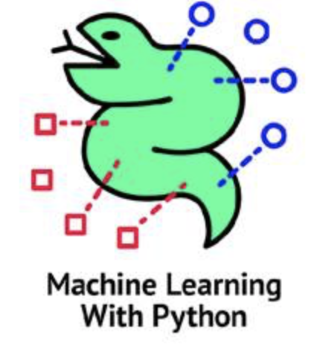
Online course “Machine Learning with Python”
Six rounds with coding assignments
Each round covers a specific topic
Round 1: “Intro”, Round 2: “Regression”, Round 3: ”Classification” …
Non-students can enroll via FiTech:
https://fitech.io/instructions-for-applying/

Slide 6
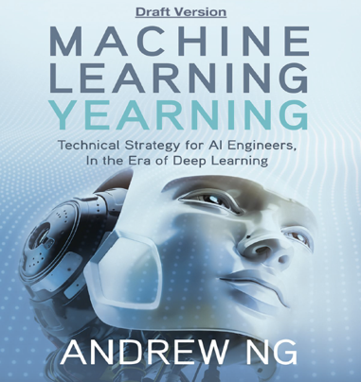
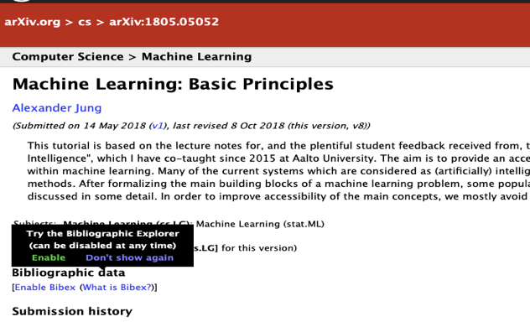
Background Material
https://arxiv.org/abs/1805.05052
https://www.deeplearning.ai/machine-learning-yearning/

Slide 7
(Artificial) Intelligence Involves (Machine) Learning
from Wikipedia:
“Among the traits that researchers hope machines will exhibit are
reasoning, knowledge, planning, learning,
communication, perception,….“

Slide 8
AI Principle (Engineer Perspective)
automatically choose (compute) optimal decisions to maximize a long-term reward

Slide 9
Machine Learning for AI
optimal decisions/planning require insights
ML extracts high-level insights from raw data
ML is low-level AI

Slide 10

What is Machine Learning?
Intelligence
Planning,
Logic, …
Machine Learning
Raw Data

Slide 11
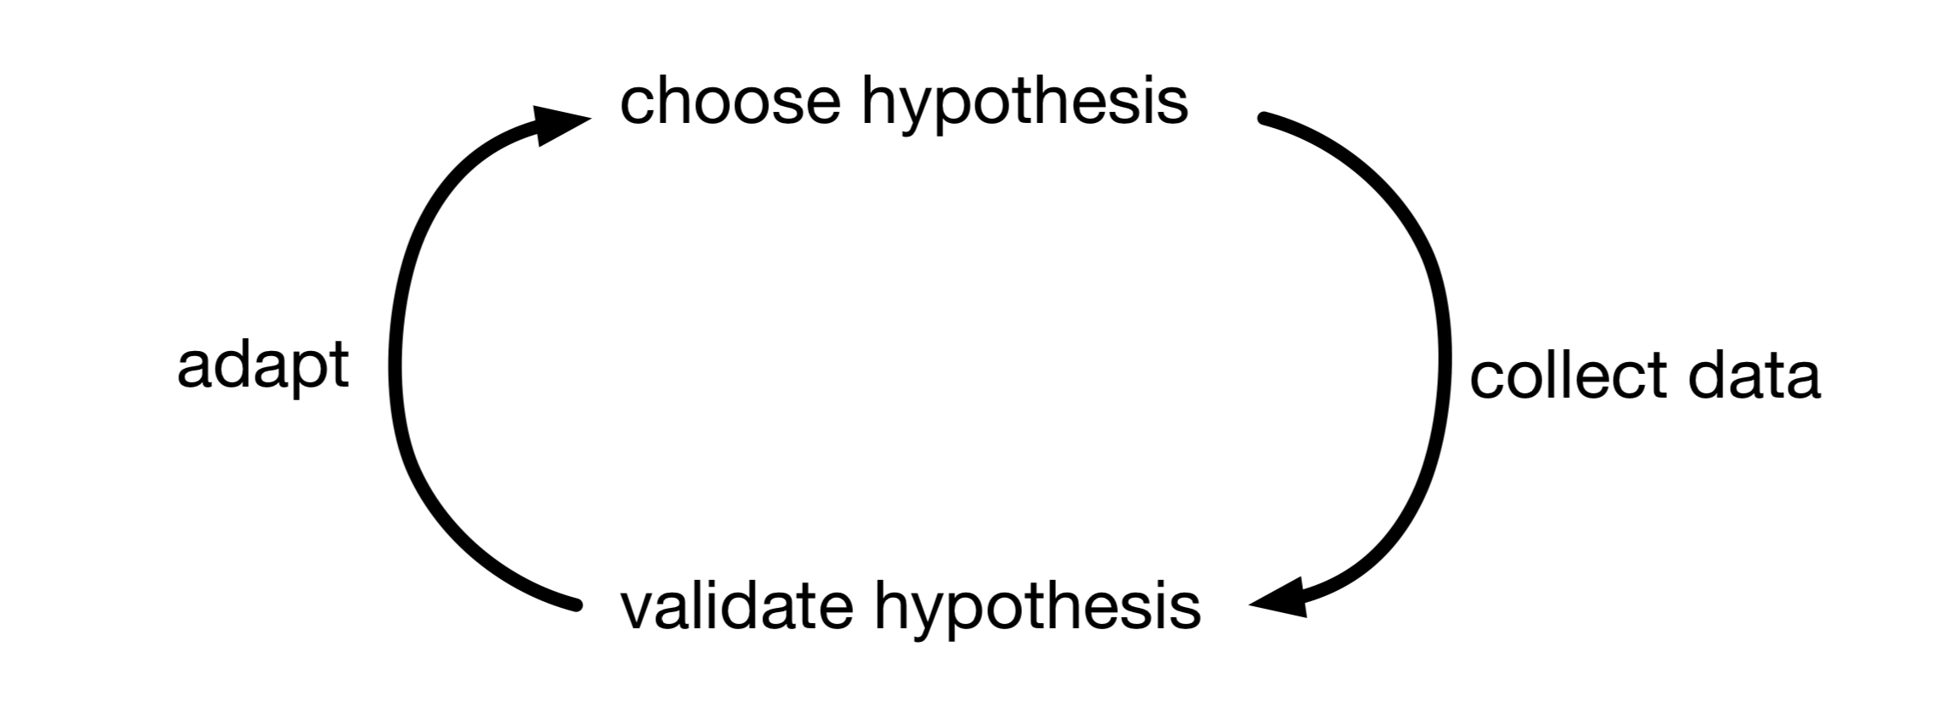
What is Machine Learning?
computer programs (algorithms) which use historic data to learn how to make good predictions

Slide 12
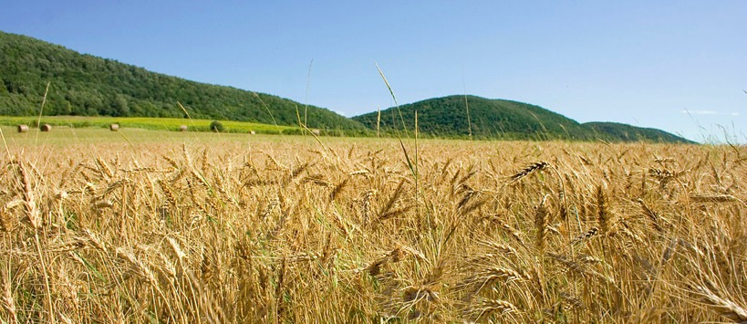
When to Harvest?

Slide 13
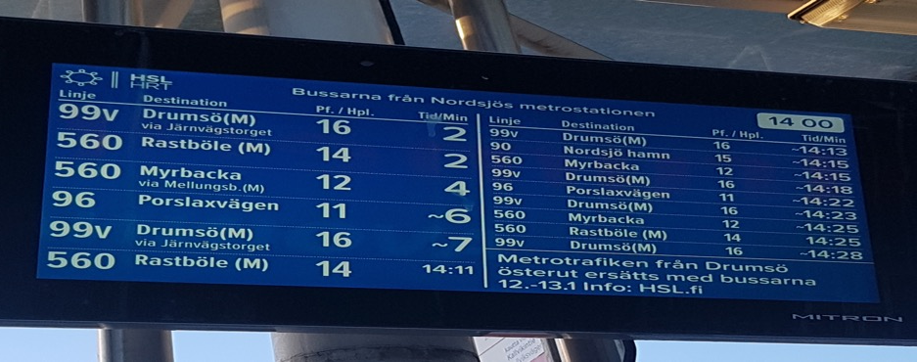
When will my bus arrive?

Slide 14
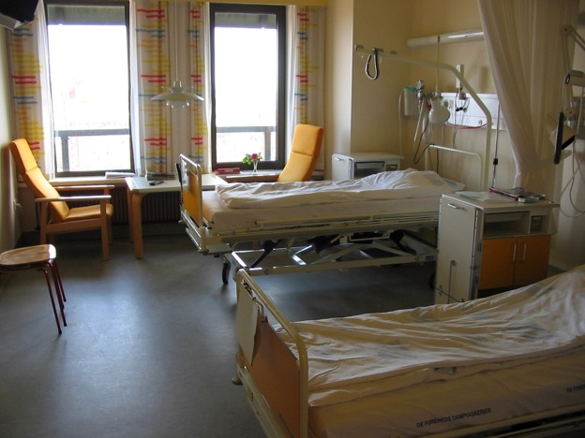
Is Everything OK? Where is the Patient?

Slide 15
Say “OK Google…“
https://www.youtube.com/watch?v=p5DVeDWtA5U

Slide 16
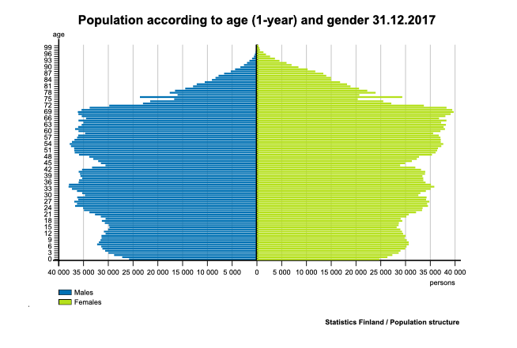
Age Distribution in Finland
old
young

Slide 17
What are Laws of Motion?
https://users.aalto.fi/~junga1/AppleFalling.mp4

Slide 18
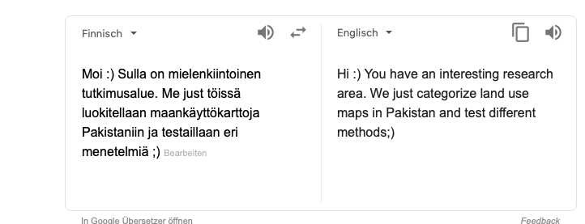
I still don’t speak Finnish ☹

Slide 19
Reliable AI
How much can we trust the prediction ?

Slide 20
Understandable AI
why this particular prediction?
e.g.: automated decision for KELA benefits
decisions require detailed justification based on law

Slide 21
Privacy Preserving AI
how to learn from data without revealing sensitive data?

Slide 22
In a Nutshell
ML methods fit (complicated) models to (tons of) data

Slide 23
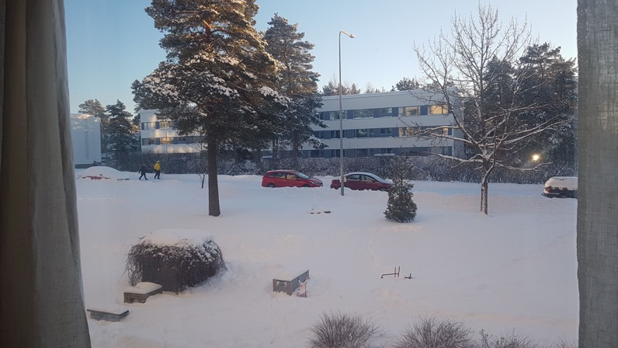
Nice Ski Day Ahead!

Slide 24

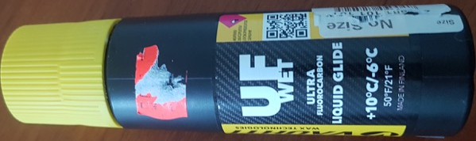
A ML Problem
plan a decent ski trip
which wax should I use?
depends on temperature during day
know the min temperature (its 07:00 am)
what will be max temperature?

Slide 25
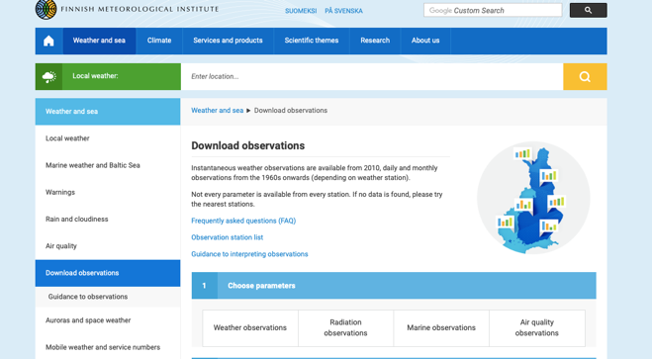
Data
https://en.ilmatieteenlaitos.fi/download-observations#!/

Slide 26
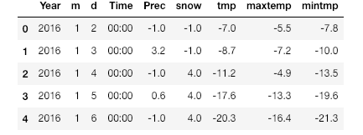
Historic Data
data point

Slide 27
Model
hypothesis: linear relation between min and max tmp
y = 3 x
y = 2 x
max temp. y
y = 1 x
min temp. x

Slide 28
Fitting the Model to Data
fit linear predictor y’=h(x) by minimizing mean squared error
historic data
linear predictor y’ = w*x
max temp y
tunable weight w
min temp x

Slide 29
How To Fit ?

Slide 30
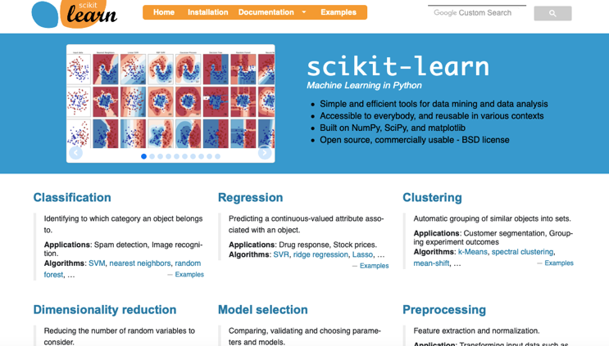
ML Methods Available in Python/MATLAB/R/…
https://scikit-learn.org/stable/

Slide 31
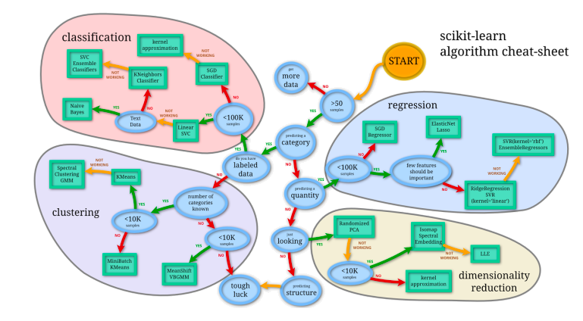
Python Cheat Sheet

Slide 32
Elements of Machine Learning

Slide 33
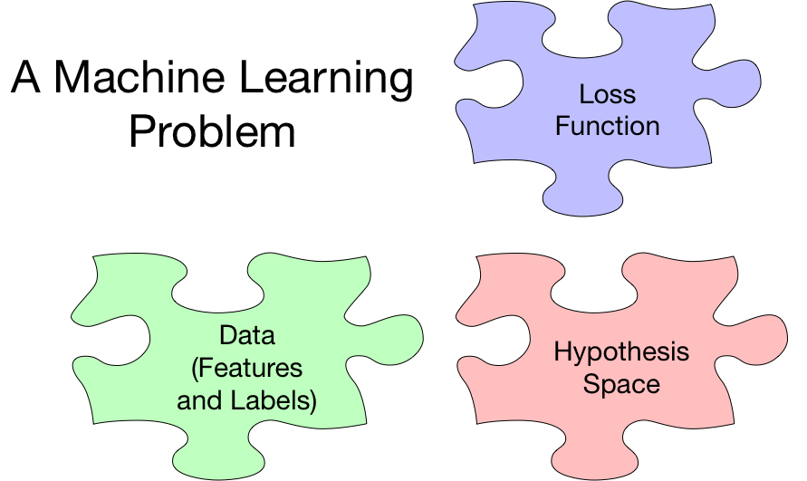

Slide 34
The Data

Slide 35
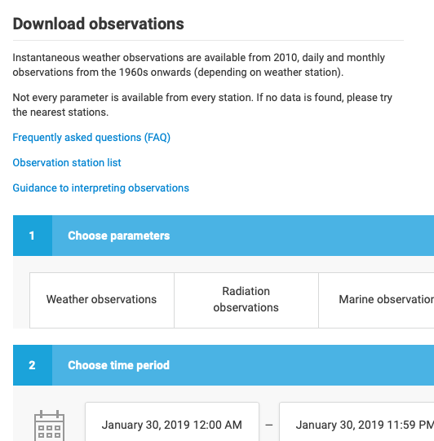

Data

Slide 36
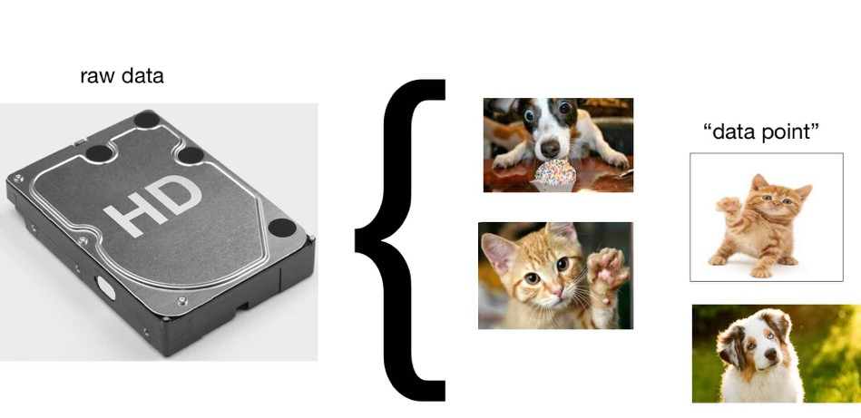
Data Points
break raw data into atomic pieces (chunks)
of data, e.g., individual files stored on hard disk

Slide 37
Data Points

Slide 38
Features for Image Data

Slide 39
Features for Time Signals

Slide 40
Features for Text
consider simple language with vocabulary {“have”, “a”, “good”, “great”, “day”}
represent words by ”one-hot encoding”
“have”=(1,0,0,0,0); „a“=(0,1,0,0,0), …., „day“=(0,0,0,0,1)
what could be feature vector of text “have have a good great day”?

Slide 41
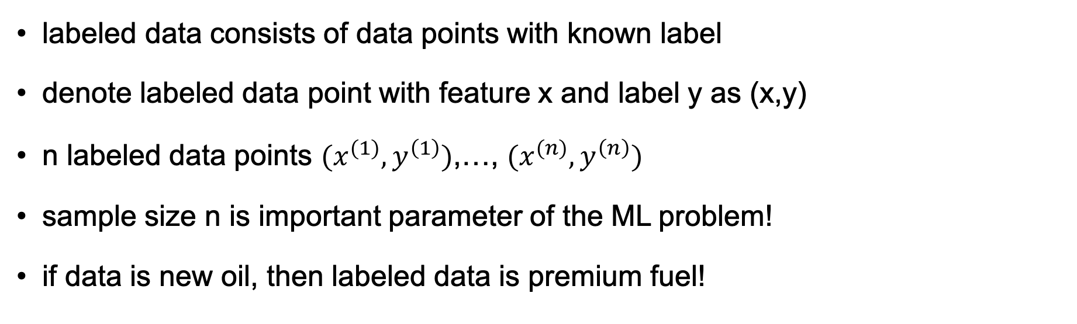
Labeled Data
labeled data consists of data points with known label
denote labeled data point with feature x and label y as (x,y)
n labeled data points $(x^{(1)},y^{\left(1\right)})$,…, $(x^{(n)},y^{\left(n\right)})$
sample size n is important parameter of the ML problem!
if data is new oil, then labeled data is premium fuel!

Slide 42

How To Get Labeled Data?
you can buy human labelling workforce!

Slide 43
Labeled Data
label

Slide 44
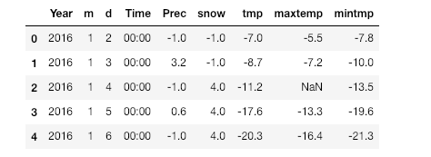
Missing Data
there are ML “autofill” tools known as “data imputation”

Slide 45
Labeled Data
“no cat”
”cat”
”cat”
“no cat”

Slide 46
Classification Problem
will max temp today be more than 0 or not ?

Slide 47

Classification Problem
does image on the left show “cat” or “no cat” ?
we can encode this by defining label of an image as y=1 if it shows cat and y=-1 if not
how can we get the true label y for an image?

Slide 48
Regression Problem
what will maxtemp be today (mintmp was -5 )?

Slide 49
Regression vs. Classification
AI engineer defines what the label is !
numeric label (e.g., max temp) yield regression problems
discrete label (e.g., “cat” vs. “dog”) yields classification
distinction between regression and classification is blurry!
“cat” vs. “dog” classification can be modeled as regression problem with numeric label y=“confidence that image shows rather cat than dog”

Slide 50
The Data – Wrap Up
collection of atomic data units “data points”
data point characterized by features and labels
features are quantities that can be determined easily
labels are difficult to determine (requires human labor)
ML methods guess label based on features

Slide 51
Hypothesis Space (“Model”)

Slide 52
Hypothesis Space
need hypothesis (model) relating features (input) and label (output)
represent hypothesis as map or function h(x)
input features x and output predicted label h(x)
other names for hypothesis map are
“predictor” for numeric labels (e.g., temperature next day)
“classifier” discrete labels ( e.g., image shows ”cat” or “dog”)

Slide 53
“Hypothesis”/”Predictor”/”Classifier” = Map from Features to Labels
map h(.)
features x
predicted label y’=h(x)
choose h(.) s.t. “predicted label $≈$ true label”

Slide 54

Example of a Predictor
map h(.)
optimal candidate
“Kalle Koivunen”

Slide 55
Example of a Predictor
map h(.)
costumer request
problem category

Slide 56
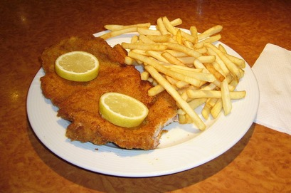
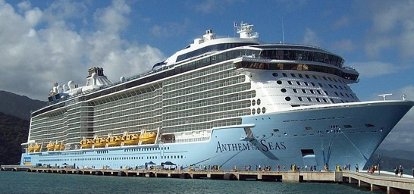
Example of a Predictor
current operational
data of cruise ship
Schnitzel demand
at next dinner?
map h(.)
from Wikimedia Commons
from Wikimedia Commons

Slide 57
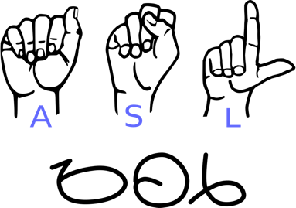
Example of a Predictor
sequence of gestures
sentence
map h(.)
“Please google …“
from Wikimedia Commons

Slide 58
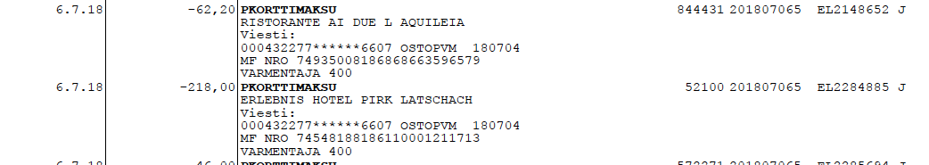
Example of a Predictor
Transaction
map h(.)
“No Money
Laundry”

Slide 59
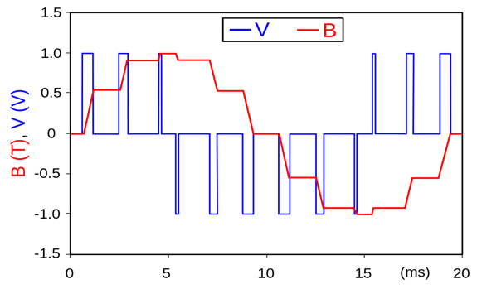
Example of a Predictor
measurements
risk of fault
within next week
map h(.)
60 %

Slide 60


Example of a Predictor
map h(.)
“Fleetwood Mac –
Don’t Stop“

Slide 61
From Predictions to Actions
this module focuses on ML methods that deliver predictions
predictions are further used e.g. to inform actions/decisions
actions then result in new data (produced by costumers)
results in a feedback loop “The Virtuous AI Cycle”

Slide 62
The Virtuous AI Cycle
AI-BASED
PRODUCT
improves
attracts
generates
DATA
USERS

Slide 63
How to Implement Predictors?
predictor is a map h(x)
maps feature x to a predicted label y’
computing a prediction amounts to evaluation the map
sounds trivial but can be challenging
how can we efficiently represent a map h(x) ?

Slide 64
Linear Predictors (Linear Regression)
label y
predictor h(x) = w * x
w=2
tunable weight w
w=1
feature x

Slide 65
Linear Predictors
widely used
lot of engineering effort to make ML methods efficient
hardware (GPUs) is tailored to linear methods
linear ML methods are a mature technology
can be used directly only with numeric features (vectors)
how to apply it to text ?

Slide 66
Decision Trees
feature x > w1 ?
tunable weights w1,w2,w4
no
yes
predictor map h(x)
x > w2 ?
x > w3 ?
no
yes
no
yes
y’=-5
y’=-2
y’=4
prediction y’=10

Slide 67
Decision Trees for Text
does x contain word w1?
yes
feature x is a tweet
no
tunable weights w1,w2,w4
predictor map h(x)
x contains w2 ?
x contains w3?
no
yes
no
yes
y’=“news”
y’=“news”
prediction y’=”fake news!”
y’=“fake news!”

Slide 68
Decision Trees
predictions arise from sequence of elementary tests
tests (e.g. x>5?) provide explanation for prediction
predict “tmp=10” because of x>5 and x<20 ….
predict “benefit granted“ due to Fact 1 and Law 1 …

Slide 69
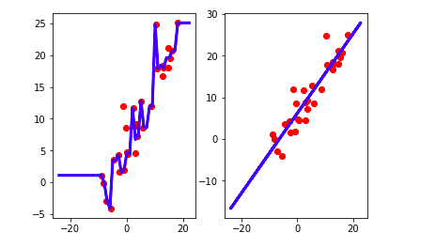
Decision Tree vs. Linear Predictor

Slide 70
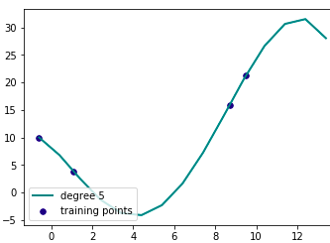
Polynomial Predictor
label y
y’ = h(x)
= w1 + w2*x + w3*x^2+w4*x^3
tunable weights w1,w2,w3,w4
feature x

Slide 71
Artificial Neural Networks
y’ = h(x)
w1
predicted label
w2
feature x
y’
tunable weights w1, w2, …

Slide 72
The Loss Function

Slide 73
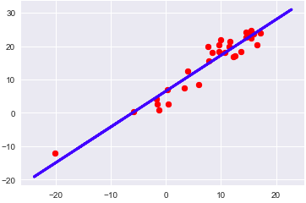
How Good is a Predictor?
define loss L(y,h(x)) of predicting true label y by y’=h(x)
y’ = h(x) = w *x

Slide 74
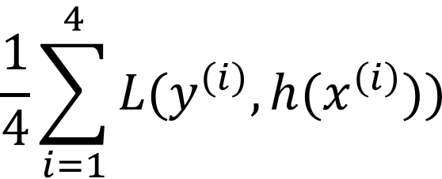
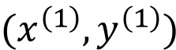
Average Loss (Empirical Risk)
y’ = h(x) = w*x
$$(x^{\left(1\right)},y^{\left(1\right)})$$
$$\frac{1}{4}\sum_{i=1}^{4}{L(y^{\left(i\right)},h(x^{\left(i\right)})})$$
label y
feature x

Slide 75
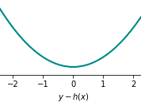
Squared Error Loss
L(y,h(x)) = (y-h(x))^2

Slide 76
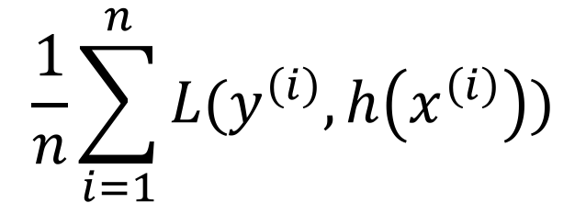
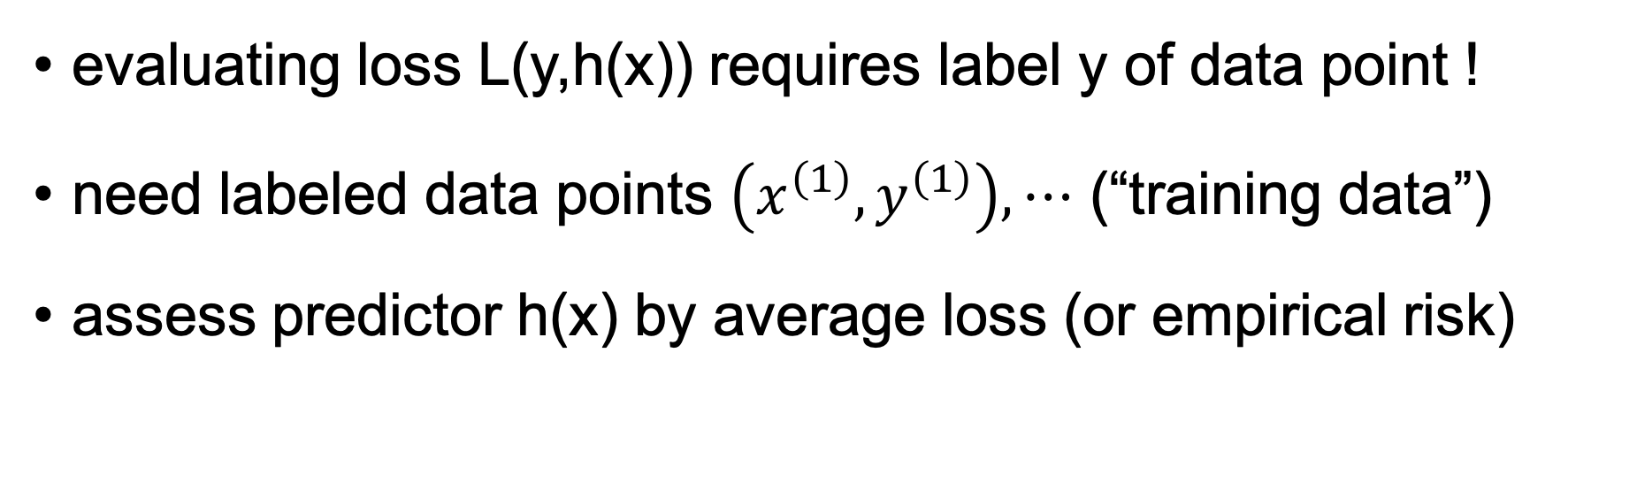
Training Data = Bunch of Labeled Data
evaluating loss L(y,h(x)) requires label y of data point !
need labeled data points $\left(x^{\left(1\right)},y^{\left(1\right)}\right),⋯$ (“training data”)
assess predictor h(x) by average loss (or empirical risk)
$$\frac{1}{n}\sum_{i=1}^{n}{L(y^{\left(i\right)},h\left(x^{\left(i\right)}\right))}$$

Slide 77
Choosing Loss Function
loss function is design choice (specified by you!)
for numeric labels, squared error loss is widely used
sq. error has nice statistical and computational properties
for discrete labels, squared error loss is not well suited

Slide 78
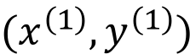
Squared Error Loss Bad for Binary Labels
h(x)
y=1
y=0
min temp x
$$(x^{\left(1\right)},y^{\left(1\right)})$$

Slide 79
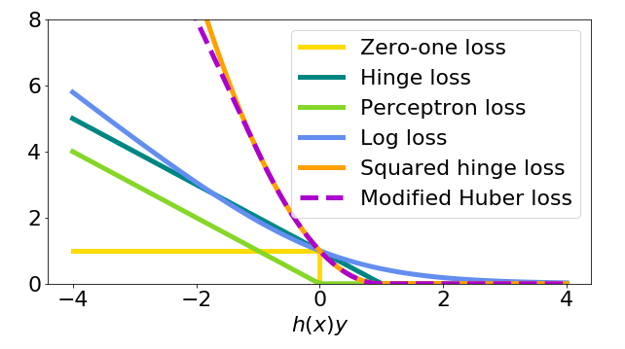
Loss Function for Binary Labels y=-1 or y=1

Slide 80
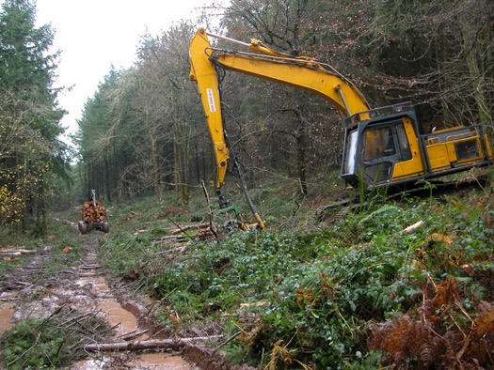
Loss Function for Binary Labels (y=-1 or y=1)
consider AI for harvester
camera snapshot is labeled y=1 (-1) if person present (absent)
loss L(y=1,y’=-1) should be very large since y=1, y’=-1 means there is person but AI misses her
loss L(y=-1,y’=1) can be small (AI sees person which is not there)

Slide 81
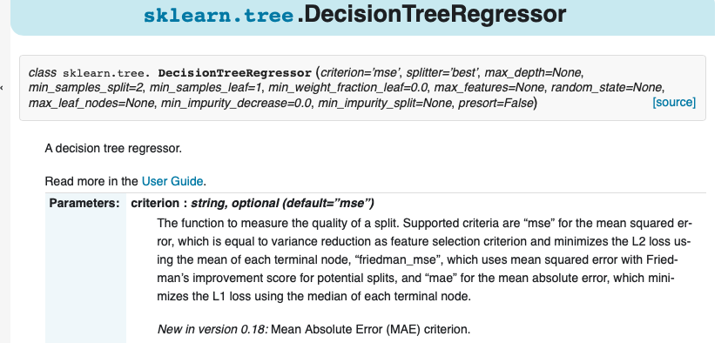
Loss Function Selection

Slide 82
Putting Together the Pieces
collect/measure/compute labeled data points
choose predictor (linear, tree, artificial neural net, …)
choose loss function
tune weights of predictor to minimize the average loss

Slide 83
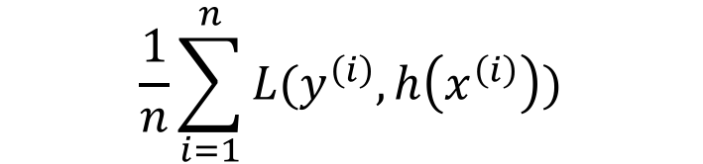
Learning/Training/Optimization/Model Fitting
$$\frac{1}{n}\sum_{i=1}^{n}{L(y^{\left(i\right)},h\left(x^{\left(i\right)}\right))}$$
linear regression
average loss on training data
deep net
tunable weights w of predictor h(x)

Slide 84
Model Selection

Slide 85
Model = Choice for Hypothesis Space
ML method/model = family of predictors with same structure
linear regression uses h(x) = w*x with tunable w
family of predictors constitutes the hypothesis space

Slide 86
Example: Linear Regression
consider data point having four features x1,…,x4
want to predict some numeric label y of data point
linear regression relates features and label via y’ = h(x) = w1*x1+w2*x2+w3*x3+w4*x4
different tuning weights w1,…,w4 yield different predictors !

Slide 87
Which Model Shall We Use?
decision trees
(deep) artificial neural nets
linear predictors
polynomial predictors
….

Slide 88
Nested Models
H_d = set of linear predictors which use first d features
H_1
H_2
H_3

Slide 89
Nested Models
define model H_d by set of polynomials with max. degree d
H_d included in H_e if d>=e
H_1
H_2
H_3

Slide 90
Nested Models
model H_d given by ANN with d hidden units
H_1
H_2
H_3

Slide 91
Training Error
consider particular model (e.g., polynomial predictor with max. degree d)
model constituted by maps with different choices for tuning weights w
choose weights by minimizing average loss (training error) over training set
if we use larger model, we can only reduce training error !
degree 5 polyn. can fit training data at least as good as degree 3 polyn.
why not simply using the largest possible model (polyn. with large degree)?

Slide 92
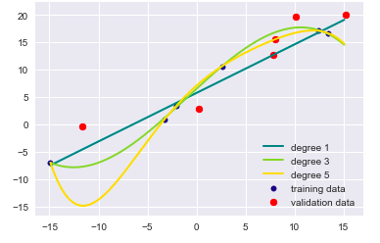
Overfitting
label y
feature x

Slide 93
Validate!
average loss E_train on training set can be misleading!
indeed, we optimize the predictor based on training set
after training, try out on different (validation) data!
compare training error E_train with validation error E_val
when E_train << E_val, ML model is overfitting !!!

Slide 94
Labeled Data
training
validation

Slide 95
Training and Validation Error

Slide 96
K-Fold Cross Validation
n labeled data points (assume n is integer multiple of K)
fold 1
…
fold K
K-fold CV involves K iterations: in each iteration choose
one fold as validation set; rest as training set
average the K validation errors

Slide 97
K-Fold CV with K=5

Slide 98
Diagnosing ML Methods
validation error
training error
desired accuracy

Slide 99
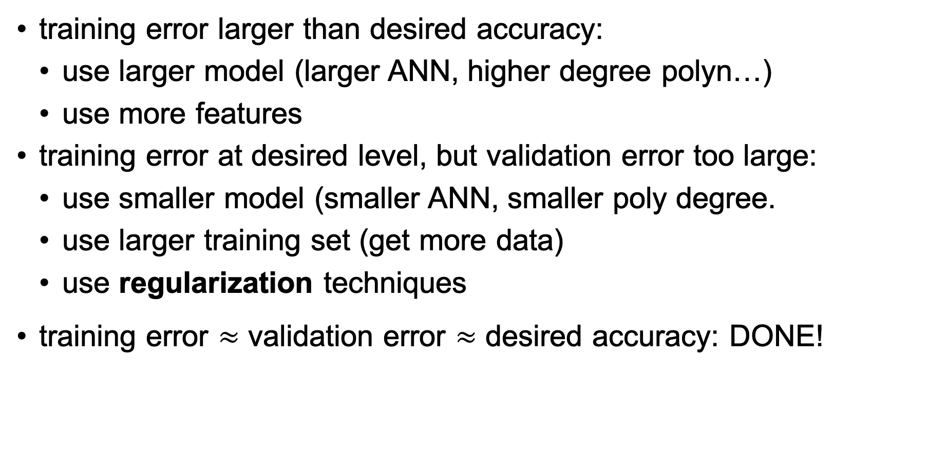
Diagnosis
training error larger than desired accuracy:
use larger model (larger ANN, higher degree polyn…)
use more features
training error at desired level, but validation error too large:
use smaller model (smaller ANN, smaller poly degree.
use larger training set (get more data)
use regularization techniques
training error $≈$ validation error $≈$ desired accuracy: DONE!

Slide 100
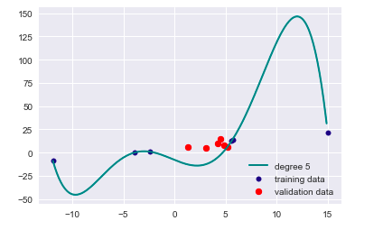
Regularization
consider polynomial predictor with max. degree 5
h(x) = w0 + w1 *x + w2*x^2 + …. w5*x^5

Slide 101

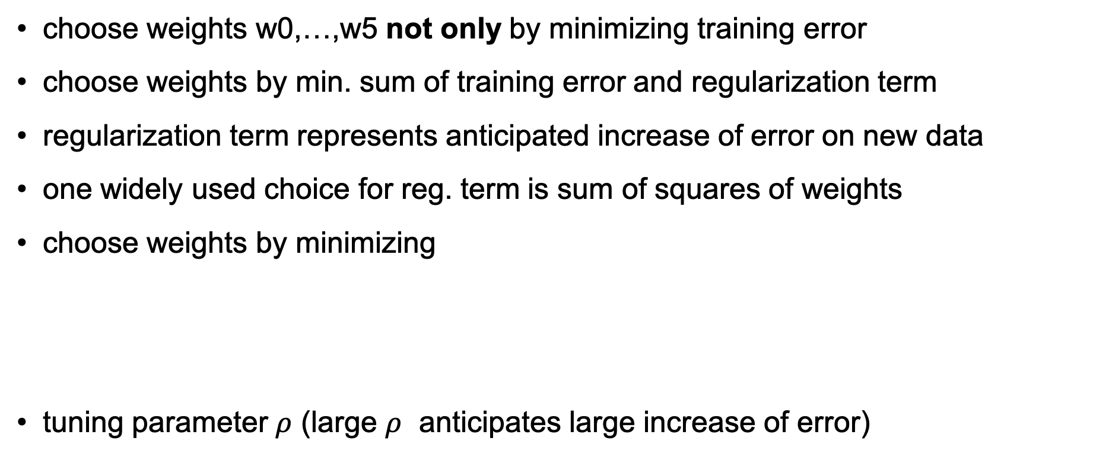
The Basic Idea of Regularization
choose weights w0,…,w5 not only by minimizing training error
choose weights by min. sum of training error and regularization term
regularization term represents anticipated increase of error on new data
one widely used choice for reg. term is sum of squares of weights
choose weights by minimizing
tuning parameter $ρ$ (large $ρ$ anticipates large increase of error)
$$\frac{1}{m}\sum_{i=1}^{m}{L(y^{\left(i\right)},h(x^{\left(i\right)})})+ρ{(w}_{0}^{2}+…+w_{5}^{2})$$

Slide 102
Lets get Hands Dirty!
get some data and define features and labels
choose ML model: linear, polynomial, ANN, decision tree
compute training and validation error
compare training, validation error with desired accuracy)
change model (enlarge/reduce model) and/or get more data
repeat

Slide 103
Clustering

Slide 104
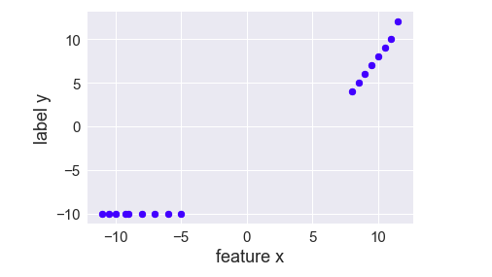
A Linear Prediction Problem
consider data points (x,y) with features x and label y
assume you want to use linear predictors to predict y from x

Slide 105
Clustering = Grouping Similar Data Points
how many cluster (groups)
do you see?

Slide 106
Two Main Flavors of Clustering
hard clustering:
each data point belongs to exactly one cluster
popular method: k-means
soft clustering:
data points belong to many clusters
data points have degree of belonging to particular cluster
popular method: Gaussian mixture models

Slide 107
Hard Clustering
cluster 1
cluster 2

Slide 108
Soft Clustering
cluster 1
Gaussian distribution
with mean m1 and cov. matrix C1
Gaussian distribution
with mean m2 and cov. matrix C2
cluster 2

Slide 109
Feature Learning

Slide 110
Long Vectors
consider data point represented as vector z of length D
what is D for a 1000 by 1000 greyscale image
what is D for a 5 sec recording of a song ?
what is D for a dictionary containing all English words?
what is D for a dictionary of English 5-grams ?

Slide 111
What is Bad About Long Feature Vectors?
computing with long vectors is time consuming
risk of overfitting
consider data points represented by vectors of length D
linear predictors overfit training data set smaller than D

Slide 112

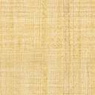
Basic Idea
raw data
reconstruction
compress
reconstruct
features
map h(z) involves tunable weights w
choose weights w to ensure small reconstruction error z-z’

Slide 113
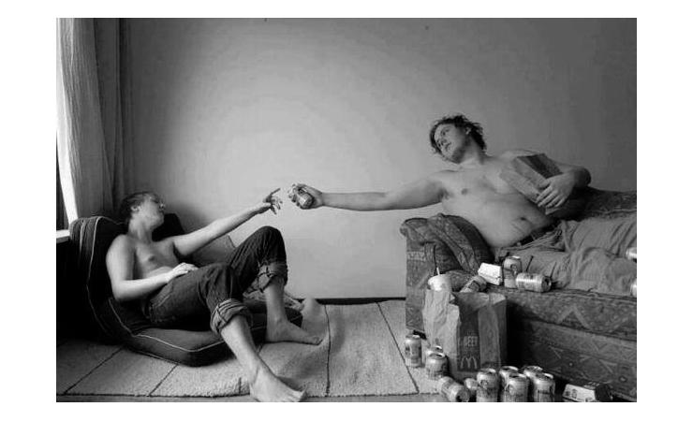

The Creation (Finnish)
raw data = 254820 pixels
reconstruction obtained from
17837 features

Slide 114
Linear Feature Learning
apply linear
map W
linear reconstruction
map R
raw data z
features x
z’
what is best choice for matrix W such that z’ close to z ?

Slide 115
Non-linear Feature Learning – “Autoencoder”
w1
raw data z
features x
reconstruction z’
w30
tunable weights w1,w2,….

Slide 116
Transfer Learning

Slide 117
Basic Idea
train ML method on different data
massive amounts of unlabeled data to pre-train ANN
small amount of high quality labeled data to fine-tune ANN
allows to compress raw data into pre-trained models

Slide 118
Model Based ML Methods

Slide 119
Model Based Machine Learning
consider data points with features x and labels y
interpret them as realizations of random variables
sequence of data points is a random process
data characterized by probability distribution

Slide 120
Condition on Data
specify joint distribution p(…) of all quantities in the model
quantities include: features, labels of data points and parameters
compute posterior distribution of variables given observed data
https://docs.pymc.io/notebooks/GLM-linear.html

Slide 121
Probabilistic Machine Learning
today at 07:00 am: mintmp=-10 maxtmp =?
compute posterior probability distribution p( hidden variables | data)

Slide 122
Two Challenges
Challenge1: how to get joint probability distribution p( data, hidden variables) ?
Challenge2: how to compute posterior distribution p( hidden variables | data) for extremely high-dim. distribution?

Slide 123
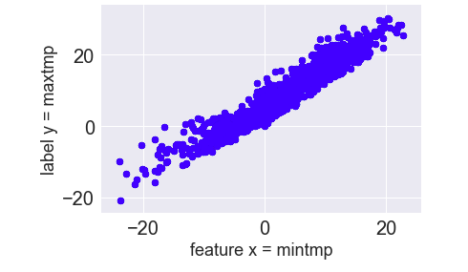
Learning Probability Distribution
what could be a good
choice for p(x,y) ?

Slide 124

Ready Made Tools
efficient methods for learning prob. distributions available
efficient methods for computing posterior p( hidden variables | data) available

Slide 125
Reinforcement Learning

Slide 126
Machine Learning vs. Reinf. Learning
”ordinary” machine learning methods consider data given
methods are passive; read in data → output prediction
reinforcement learning takes effect of predictions into account
predictions incur decisions/actions
decisions/actions influence the data which is observed next

Slide 127

Cleaning Robot

Slide 128
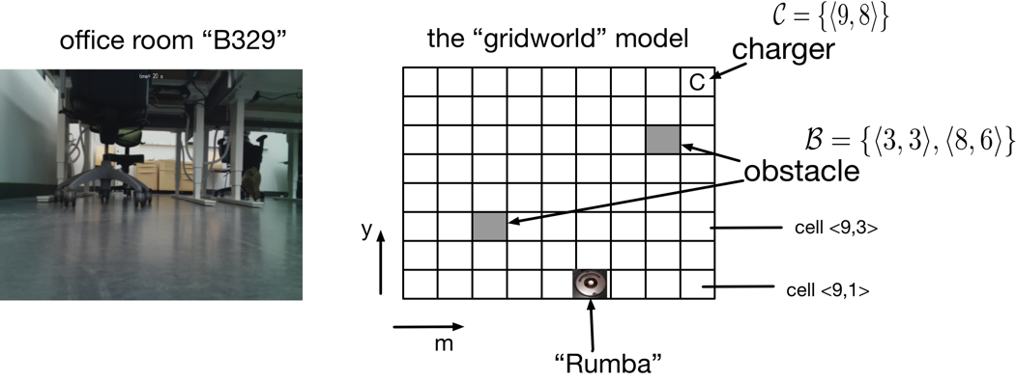
Office Room

Slide 129
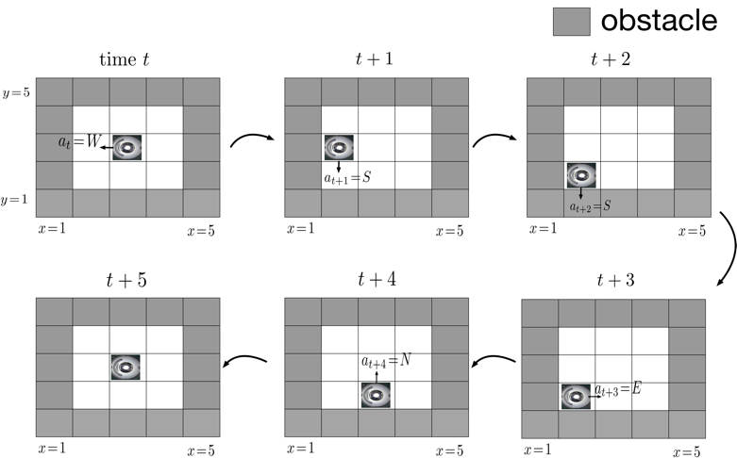
Actions
action y_t at time t is direction to move next

Slide 130

Reinforcement Learning Problem
given snapshot of onboard camera,
what is best direction to move next
features x = pixels of snapshot
label y = optimal direction to move next
We do not know the true label here!
We can only observe the effect of choosing
some direction!

Slide 131
Markov Decision Process
interaction between AI (cleaning robot) and environment (office room)
at time t, observe snapshot x_t
based on snapshot decide for next direction y_t
measure amount r_t of dust collected at time t
sequence x_1,y_1,r_1,x_2,y_2,r_2 modelled as a Markov decision process
MDP is a special type of random process

Slide 132
Optimal Policy
AI cleaning robot implements a policy h(x)
policy takes input x (snapshot) and outputs y (direction of next move)
policy map h(x) depends on tunable weights (like predictors !)
RL amounts to tuning h(x) such that reward is maximized
AI engineer defines what the “reward” is (e.g., amount of dust collected)

Slide 133
That’s It Folks!

